Slide 1
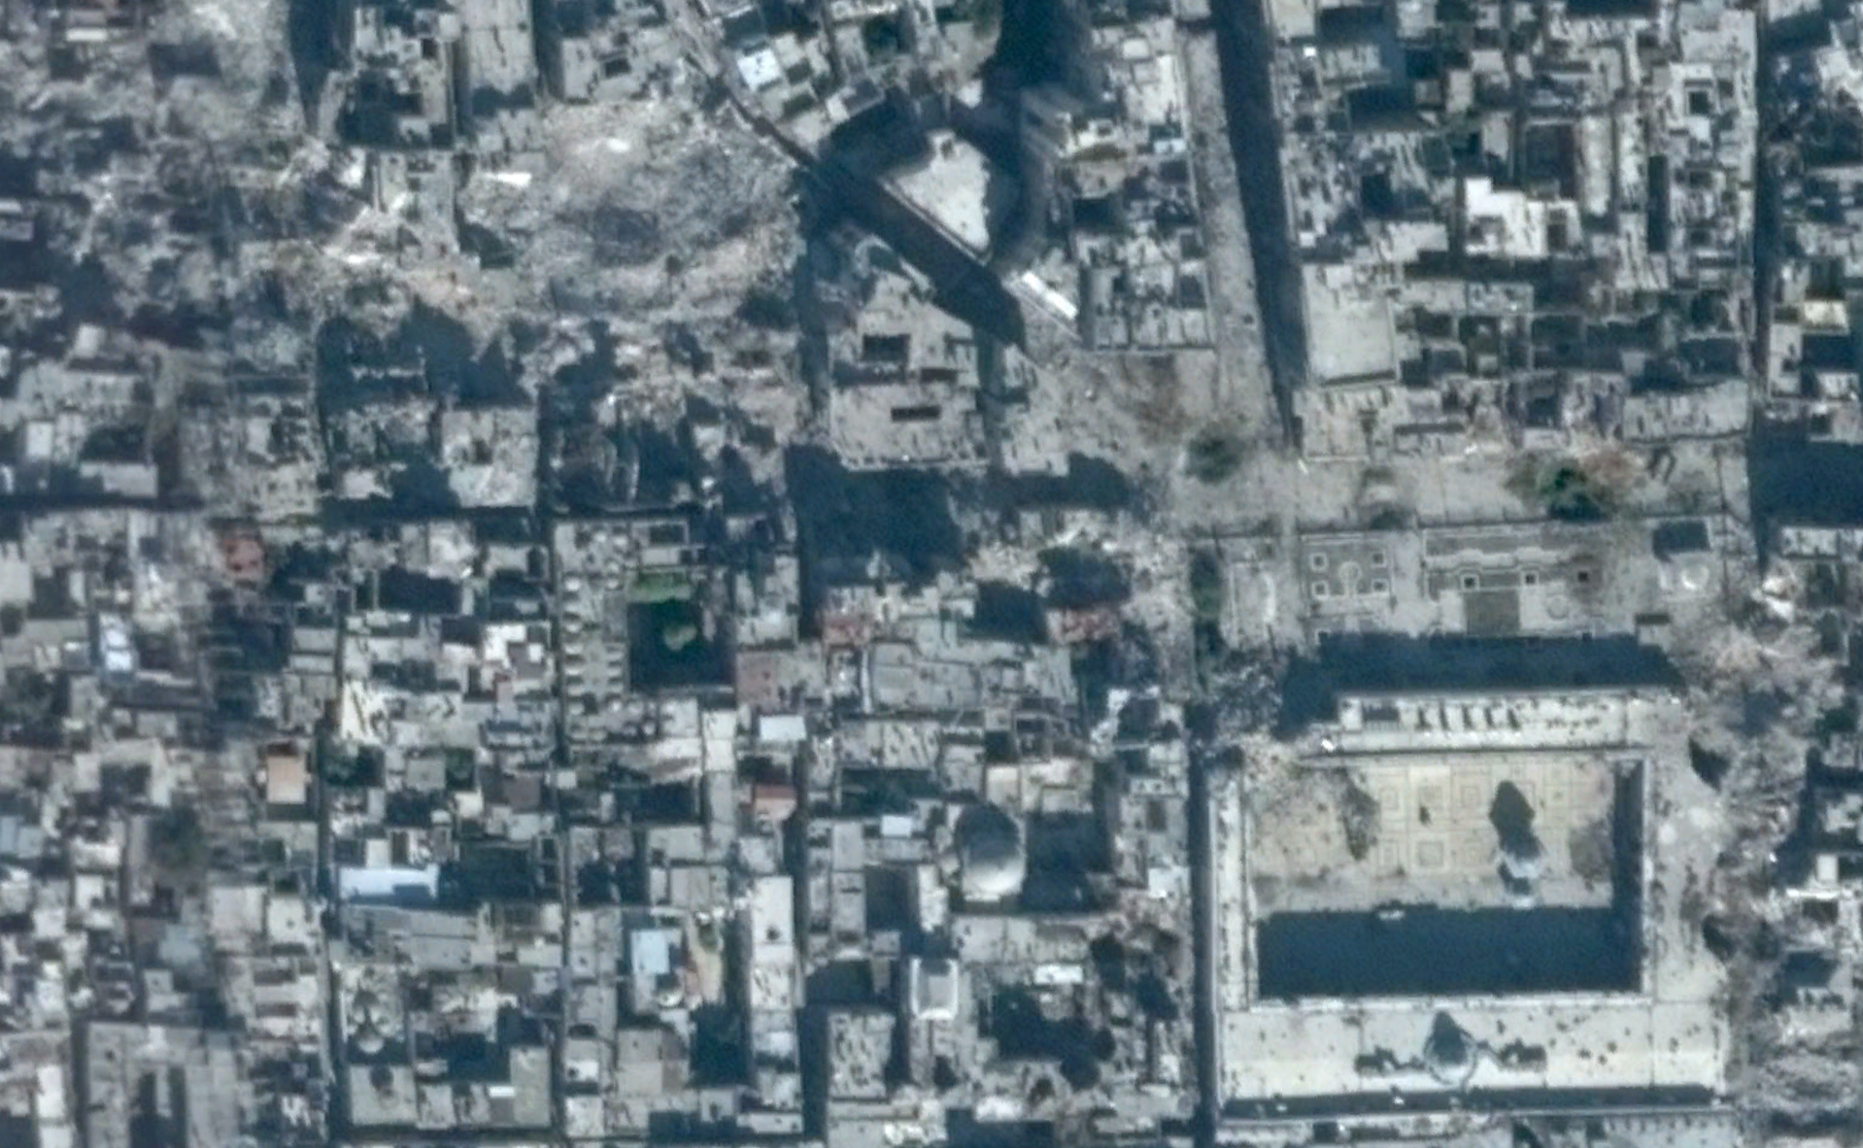
2. Introduction to Plotting with ggplot2
Jonathan Hersh, PhD (Chapman Argyros School of Business)
12/7/20

Slide 2
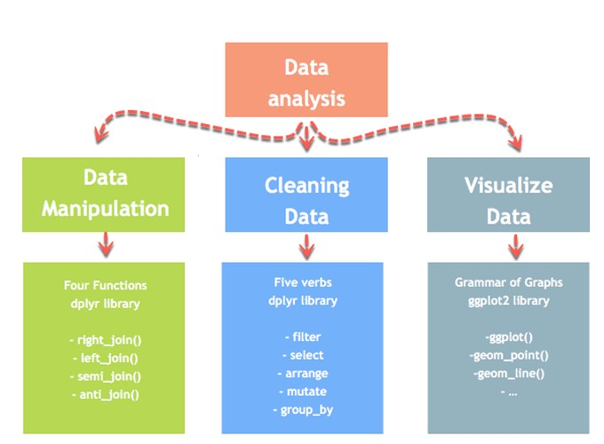
Data Manipulation Process

Slide 3
Basic ggplot2 Syntax
“The simple graph has brought more information to the data analyst’s mind than any other device.” — John Tukey
ggplot(data = <DATA>) +
<GEOM_FUNCTION>(mapping =aes(<MAPPINGS>))

Slide 4
Basic ggplot2 Syntax

Slide 5
